Slide 1
Computer Vision​
Final Project Presentation
Group 11
Member: 111063517 李聖謙、111063548 蕭方凱
111063578 賴家均、111061551 宋乃仁
Professor: 孫民博士

Slide 2
Outline
01
02
03
Problem Motivation
Technical Approach
Results

Slide 3
Problem Motivation

Slide 4
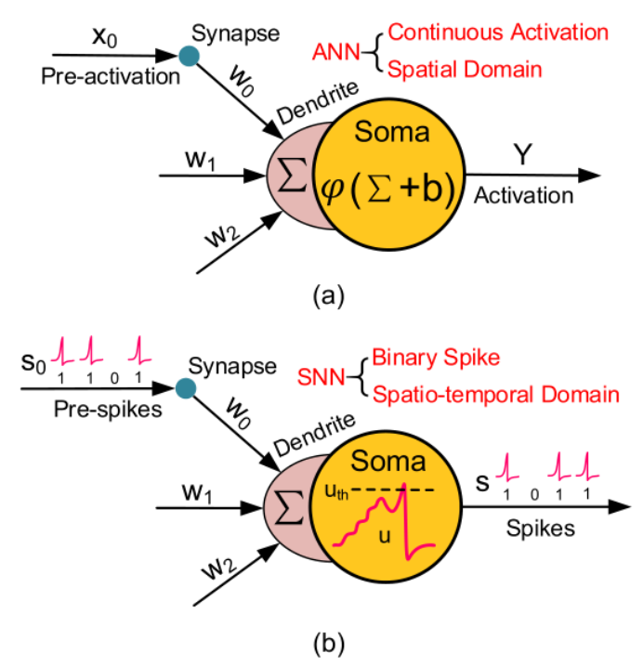
Spiking Neural Networks
Third-generation of NNs, which are more close to natural NNs than ANN
Neurons only transmit data when membrane potential reaches threshold
Transmitted spikes will increase/decrease membrane potential of other neurons
SNNs utilize the concept of time during execution

Slide 5
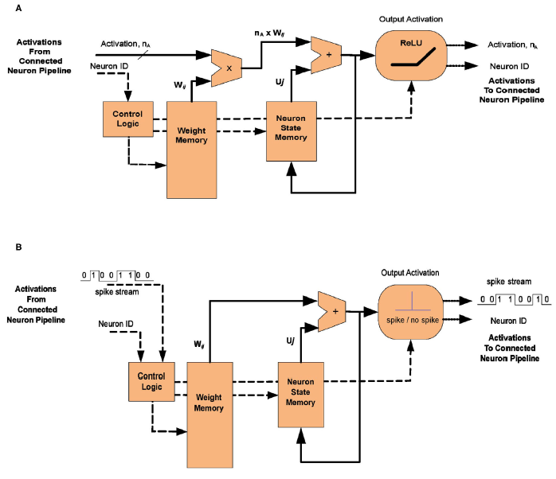
Advantage
Energy Efficiency
Area Efficiency
Efficient On-Chip Learning
Fault Tolerance

Slide 6
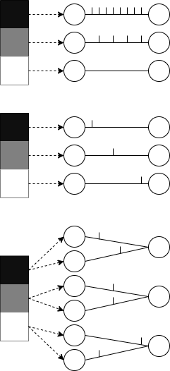
Encoding
Rate Coding
The neurons corresponding to inputs with the highest intensities fire more frequently
Temporal Coding
The neurons corresponding to inputs with the highest intensities fire first
Population Coding
The spike times of several input neurons are used to represent the input data

Slide 7
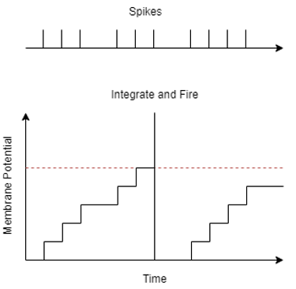
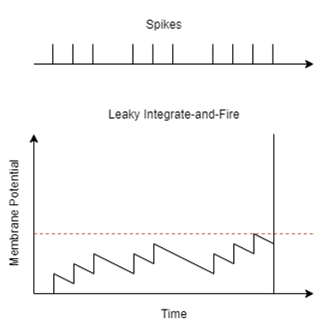
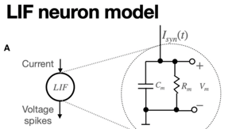
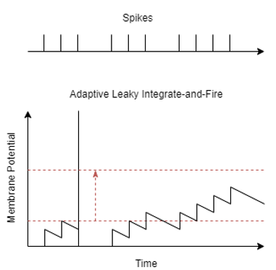
Neural Models
Integrate-and-Fire (IF) Model
The membrane potential increments until it reaches a specified threshold
Leaky Integrate-and-Fire (LIF) Model
Like the IF model except the membrane potential decrements towards a resting value
Adaptive LIF Model
Like the LIF model except the threshold value increments each time the neuron fires

Slide 8
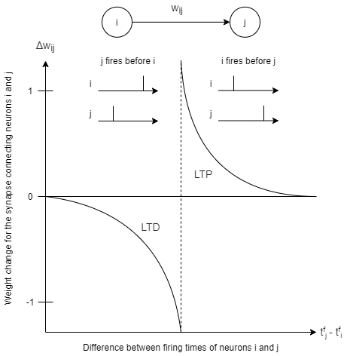
Learning Methods
Spike-Timing-Dependent-Plasticity (STDP)
Weight is increased if pre-synaptic neuron fires just before post-synaptic neuron
Also known as long-term potentiation (LTP)
Weight is decreased if post-synaptic neuron fires just before pre-synaptic neuron
Also known as long-term potentiation (LTP)

Slide 9
Learning Methods
Supervised STDP via a Teacher Signal
Output neurons are forced to spike for their corresponding labels
Weighted STDP
The negative and positive updates are weighted
Hebbian learning
The update is only positive regardless of the order
Biologically Inspired Backpropagation
Others

Slide 10
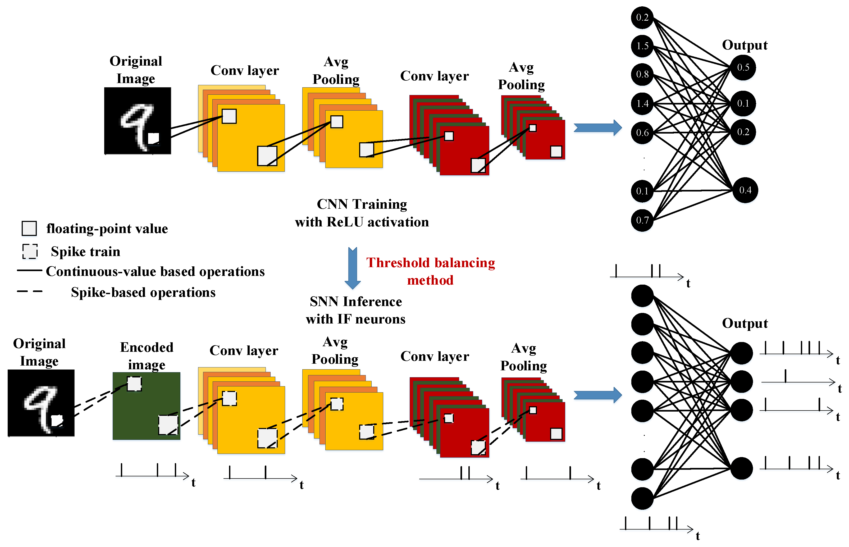
Motivation
Achieve higher accuracy in image classification tasks
Capable to be utilized across various datasets
Optimize SNNs through new encoding methods, novel models or architectures, and innovative learning approaches

Slide 11
Technical Approach

Slide 12

Adaptive
Network
Spiking neurons
Adaptive threshold
Spiking trace
Synapse model
Notes:
Next, I would like to introduce some key features of the Adaptive network:
Pulse Neurons: The Adaptive network employs a pulse neuron model, where each neuron emits a pulse when reaching a voltage threshold. This behavior is like biological neurons.
Adaptive Threshold: Each neuron has an adaptive threshold that dynamically adjusts based on the neuron's pulse emission. After a pulse, the threshold increases, making it more challenging for the neuron to emit pulses again, simulating some aspects of biological neuron behavior.
Pulse Tracking: Neurons in the Adaptive network can choose to record pulse tracking, allowing observation of neuron activity during network training or testing.
Synaptic Model: In the Adaptive network, synapses play a crucial role. The synaptic model in Adaptive network includes features such as synaptic weights and learning rules.
這些是Diehl和Cook网络的一些关键特点:
脉冲神经元： Diehl和Cook网络使用的是脉冲神经元模型。每个神经元在达到特定的电压阈值时会发放一个脉冲，这种方式与生物神经元的行为更为相似。
自适应阈值： 每个神经元都有一个自适应阈值，这个阈值会根据神经元的脉冲发放情况进行动态调整。脉冲发放后，阈值会上升，使得神经元更难再次发放脉冲，从而模拟了生物神经元的一些行为。
脉冲追踪： Diehl和Cook网络中的神经元可以选择记录脉冲追踪，以便在网络训练或测试过程中观察神经元的活动。
突触模型： Diehl和Cook网络中，突触起着非常重要的作用，dielhandclook中突触模型特点包含突觸權重和學習規則等。

Slide 13
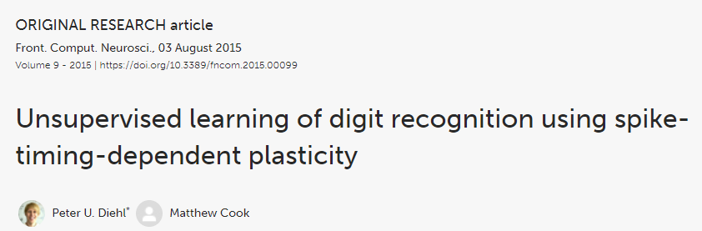
DiehlAndCook Network
A neural network model proposed by Diehl and Cook in their 2015 paper
🔗https://www.frontiersin.org/articles/10.3389/fncom.2015.00099/full
Notes:
In the presentation , we will focus on Diehl and Cook network:
This neural network model was proposed by Diehl and Cook in a paper published in 2015. The network model is based on the concept of Spiking Neurons, where neuron activation occurs through pulses, differing from traditional neural network models.
The paper primarily discusses their introduced unsupervised learning model based on spiking neurons and spike-timing-dependent plasticity (STDP). This model combines biologically-inspired neuron models and synaptic plasticity rules, achieving unsupervised learning and recognition of digital images.
In our project, we also try to incorporate the Diehl and Cook network, adjusting certain parameters to enhance the final accuracy.
##############################################################################################################################
Without further ado, I will provide a quick overview of the Diehl and Cook network and outline the parameters we modified to optimize the results.
接下來我要為各位介紹dielhandcook network:
這是一個神經網路模型，由Diehl和Cook在2015年的论文中提出，这个网络模型是基于脉冲神经元（Spiking Neurons）的理念，其中神经元的激发是通过脉冲的方式进行的，与传统的神经网络模型不同。
而这篇论文主要介绍了他们提出的基于脉冲神经元和时序相关可塑性（spike-timing-dependent plasticity，STDP）的无监督学习模型，该模型结合了生物学启发的神经元模型和突触可塑性规则，实现了对数字图像的无监督学习和识别。
在我們的project中，我們也嘗試引用此network，調整一些參數去提高最後的準確率，
Without further ado，我將快速介紹dielhandcook network及我們調整了那些參數去優化結果。

Slide 14
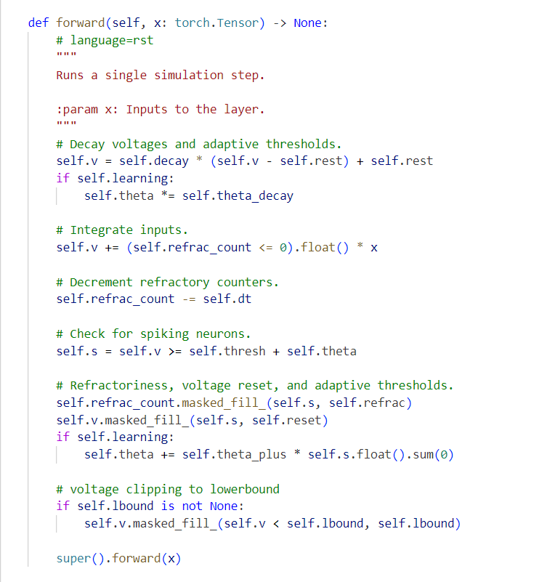
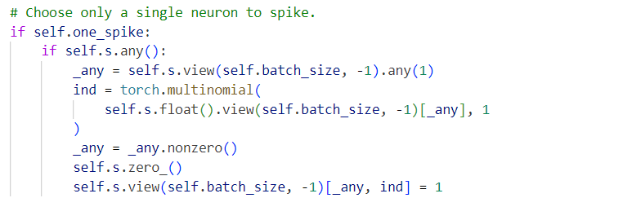
Adaptive LIF VS Diehl And Cook
ADD
The layer of adaptive LIF neurons further operated in a way that only one excitatory neuron fired per input
Notes:
Before delve in Diehl And Cook, I think understand the relation between adaptive model and Diehl And Cook is important.
In the left code , we emulate the fundamental behavior of a neuron, taking into account the membrane potential (self.v), the threshold (self.thresh), and several parameters influencing simulation behavior, such as handling refractory periods and spiking neuron characteristics. This design is common adaptive model.
首先，讓我們看一下第一段程式碼。這段程式碼實現了神經元的一個前向傳播操作，模擬了神經元使用Adaptive LIF 的情形。在這裡，我們有神經元的膜電位（self.v），閾值（self.thresh），以及一些控制模擬行為的參數。例如處理不應期和處理尖峰神經元。
We turn to the code on the right. Compared with the normal Adaptive LIF model, Diehl And Cook introduced a new flag called self.one_spike, which indicates whether only one neuron is allowed to spike in a single time step. After checking whether a neuron spike an action potential, we select only one neuron to spike.
Each excitatory layer neuron was connected to only one neuron in the inhibitory layer. On the other hand, the output of the neurons in the inhibitory layer were connected to all the neurons of the excitatory layers except for the one it received input from. Other excitatory neurons were inhibited once an excitatory neuron emitted a spike. An inhibitory neuron inhibited the internal voltage of a neuron once it received a spike. This was helpful since an active neuron could prevent the voltage of other neurons from increasing. Theoretically, this makes the model more flexible.
我們轉向第二段程式碼，與正常的Adaptive LIF model 相比Diehl And Cook引入了一個新的定義 self.one_spike引入了一個新的標誌 self.one_spike，它表示是否僅允許一個神經元在單個時間步中發放動作電位。在檢查神經元是否發放動作電位後，我們只選擇一個神經元進行發放。
這會使每個興奮層神經元僅與抑制層中的一個神經元連接。 另一方面，抑制層神經元的輸出連接到興奮層的所有神經元，除了接收輸入的神經元。 一旦興奮性神經元發出尖峰，其他興奮性神經元就會受到抑制。 一旦收到尖峰，抑制神經元就會抑制神經元的內部電壓。 這很有幫助，因為活躍的神經元可以防止其他神經元的電壓增加。理論上，使得模型更具有靈活性。

Slide 15
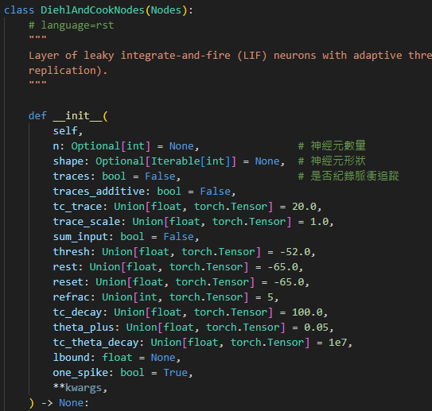

Spiking Neurons and Synapse Model
leaky integrate-and-fire model:
E_{rest}: resting membrane potential
E_{exc}: equilibrium potentials of excitatory synapses
E_{inh}: equilibrium potentials of inhibitory synapses
g_{e}: the conductances of excitatory synapses
g_{i}: the conductances of inhibitory synapses
If V > Vthres:
> 0
the neuron fires and its membrane potential will be reset!
Notes:
(左上圖)
To simulate the dynamics of neurons, Diehl and Cook utilize the leaky integrate-and-fire model. Based on biological observations, the equation introduces a time constant τ and is designed such that the time constant for excitatory neurons is longer than that for inhibitory neurons
為了模擬神經元的動態，diehlandcook使用了漏電積分放電模型，根據生物學觀察，此公式引入了時間常數 τ，並設計成興奮性神經元的時間常數較抑制性神經元更長。
################################################################################################################################################
(左下圖)
When the membrane potential voltage of a neuron crosses its threshold voltage, the terms on the right side of the equation become positive.
This triggers the firing of an action potential, and during the firing, the membrane potential of the neuron is reset to reset voltage, this signifies the discharge process of the membrane potential, and in the next few milliseconds, the neuron enters a refractory period where it cannot fire action potentials.
The incorporation of action potential firing and refractory periods in this equation aligns the computational model more closely with the actual functioning of biological neurons. It also simplifies the model, which is beneficial for handling a large number of neurons and synapses. Therefore, the leaky integrate-and-fire model is an approach that balances biological realism and computational efficiency.
當神經元的膜電位 V越過其膜閾值Vthres時，導致方程式右側的項目變為正值。這將觸發神經元發放動作電位，發放動作電位的同時，神經元的膜電位被重置為 Vreset​，這代表神經元進入了膜電位的放電過程，在接下來的幾毫秒內，神經元處於不再能發放動作電位的不可激活期。
此公式發放動作電位及停止激活的動作可使模型運算更符合實際生物神經元的工作方式，也可使模型更簡化，這對於處理大量神經元及突觸時會非常有用。
所以可見漏電積分放電模型是一個可以同時保持生物合理性和顧及計算效率的方法。
################################################################################################################################################
(右圖)
This is a segment of the diehlandcook code, containing numerous adjustable parameters.
Some of these parameters are related to the dynamic changes in the membrane potential of neurons and the firing of action potentials, namely thresh, rest, reset and refrac:
Thresh is a spike threshold voltage, representing the membrane threshold for firing.
Rest is a resting membrane voltage, indicating the baseline membrane potential.
Reset is a post-spike reset voltage, the membrane potential value after an action potential.
Refrac is a refractory (non-firing) period of the neuron, denoting the duration during which the neuron cannot fire.
這是一段dielhandcook的程式碼，裡面有許多可調整的參數，
其中有幾個參數與神經元的膜電位動態變化以及動作電位的發放有關，分別為:
thresh: Spike threshold voltage，即膜閾值。
rest: Resting membrane voltage，即靜息膜電位。
reset: Post-spike reset voltage，即動作電位後的膜電位重置值。
refrac: Refractory (non-firing) period of the neuron，即神經元的不發放期。
所以在優化的過程我們也嘗試調整這些參數，稍後會show調整後的結果。

Slide 16

Learning and Homoeostasis
What is presynaptic and postsynaptic neuron?
Presynaptic neuron
Postsynaptic neuron
the weight change Δw is calculated based on the presynaptic trace
Target value
presynaptic trace
η: learning-rate
w_{max} : maximum weight
x_{pre} : presynaptic trace
x_{tar} : target value of the presynaptic trace at the moment of a postsynaptic spike
μ determines the dependence of the update on the previous weight
Notes:
(左上圖) Before explaining the learning mechanism of Diehl and Cook, let's briefly introduce what presynaptic and postsynaptic mean.
The presynaptic terminal refers to one end of the input neuron, typically the point where neurotransmitters are released.
When the presynaptic neuron is stimulated, it releases chemical signals that propagate to the adjacent postsynaptic neuron.
The postsynaptic terminal is the end of a neuron that receives signals from the presynaptic neuron.
The release of neurotransmitters by the presynaptic neuron may trigger an action potential in the postsynaptic neuron.
在說明diehlandcook的學習方式前，先簡單介紹一下甚麼是前突觸和後突觸，前突觸是指輸入神經元的一端，通常是釋放神經遞質的端點，當前突觸神經元被刺激時，它會釋放化學信號，這些信號會傳播到相鄰的後突觸神經元 後突觸則是指接收來自前突觸神經元的信號的神經元的一端。當前突觸釋放神經遞質時可能觸發後突觸神經元的動作電位。
################################################################################################################################################
(左下圖)
The Diehl and Cook network employs spike-timing-dependent plasticity (STDP) for learning across all synapses from input neurons to excitatory neurons, STDP allows dynamic adjustments of synaptic weights based on the temporal correlation of neuron activations.
Specifically, the direction of synaptic weight changes is different when the presynaptic neuron is activated before or after the postsynaptic neuron firing, this ability enables neurons to capture temporal correlations among inputs, enhancing the model's learning and adaptability.
Let’s look at the equation, we can see that the higher the target value, the lower the synaptic weight will be.
This ensures that presynaptic neurons that rarely lead to firing of the postsynaptic neuron will become more and more disconnected, which is very useful.
Furthermore, in addition to synaptic weights, each synapse retains another value called the presynaptic trace . When a presynaptic pulse reaches the synapse, x pre increases by 1; otherwise, x pre decays exponentially.
When a postsynaptic pulse arrives, the weight change Δw is calculated based on the presynaptic trace. This mechanism contributes to improved simulation speed.
Dielhandcook network 從輸入神經元到興奮性神經元的全部突觸都使用 STDP 進行學習，STDP允許突觸權重根據神經元的時序相關性進行動態調整，
也就是說當前突觸在後突觸神經元發放之前或之後激活時，突觸權重變化方向是不同的，這使得神經元能夠捕捉到輸入之間的時序相關性，這對於模型的學習和適應能力很重要。
另外，突觸動態是使用突觸追蹤來計算的。
這意味著，除了突觸權重之外，每個突觸還保留另一個值，即前突觸跟蹤 x pre，每次前突觸脈衝到達突觸時，xpre增加 1，否則 x pre 將以指數方式衰減。
當後突觸脈衝到達突觸時，基於前突觸跟蹤計算權重 變化 Δw，這種機制可以提高模擬速度。
################################################################################################################################################
(右圖)
In the learning process of the neuron model, the activity of neurons is typically tracked, and these traces can influence the adjustment of synaptic weights.
In our code, a parameter more relevant to the learning rule theory is "trace_scale.“
It is a factor used to scale the membrane potential traces of neurons, and can be used to control the extent of the trace‘s impact.
Therefore, we experimented with adjusting this parameter to optimize the results.
The aforementioned details cover the Diehl and Cook network techniques we utilized in our project.
Next, we invite the next student to report on the project results.
在我們程式碼中與learning rule理論較為有關的參數為trace scale。
在神經元模型的學習過程中，通常會跟踪神經元的活動，這些跟踪可以影響突觸權重的調整。
trace_scale是一個用於縮放神經元膜電位跟踪的因子，可用於控制跟踪的影響程度。
所以我們嘗試調整此參數去優化結果。
以上為我們在專題上使用到的dielhandcook network技術，接下來我們請下位同學報告project result的部分。

Slide 17
Results

Slide 18
Parameter adjustment
Adjustment:
trace_scale : 1 => 0.5
tc_theta_decay : 1e7 => 1e5
trace_scale:
1.Sensitivity of Spike Trace
2.Learning Speed of the Model
3.Impact on Model Memory
4.Effect on Adaptive Thresholds
Tc_theta_decay:
1.Decay Rate of Adaptive Threshold
2.Impact on Long-Term Memory in
the Model
3.Effect on Learning Stability:
Learn rule
Weight Dependent PostPre
Hebbian
The impact of trace_scale on Hebbian:
trace_scale may influence the strengthening of synaptic weights.
The impact of Tc_theta_decay on Hebbian:
changes in Tc_theta_decay will directly affect the decay rate of the adaptive threshold..
The impact of trace_scale on WDP:
variations in trace_scale will directly affect the sensitivity of spike trace.
The impact of Tc_theta_decay on WDP:
changes in Tc_theta_decay will directly affect the decay rate of the adaptive threshold.

Slide 19
Result

Slide 20
Thanks for listening

